Slide 1
PART ONE Deep Convolutional Neural Network for Visual Microphone

Slide 2
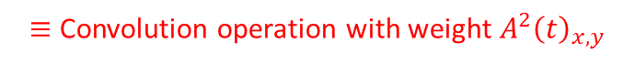
Visual Microphone
Let:
$$A{\left(t\right)}_{x,y,ω,θ}$$
Amplitude
$${δ\left(t\right)}_{x,y,ω,θ}$$
Phase
Phase difference
(i.e. estimated displacement)
$$δ^{′}{\left(t\right)}_{x,y,ω,θ}={δ\left(1\right)}_{x,y,ω,θ}−{δ\left(t\right)}_{x,y,ω,θ}$$
For simplicity.. Consider only one scale and orientation.
Then:
$$s\left(t\right)=\sum_{x,y}{A^{2}{\left(t\right)}_{x,y}δ^{′}{\left(t\right)}_{x,y}}$$
$≡$ Convolution operation with weight $A^{2}{\left(t\right)}_{x,y}$

Slide 3
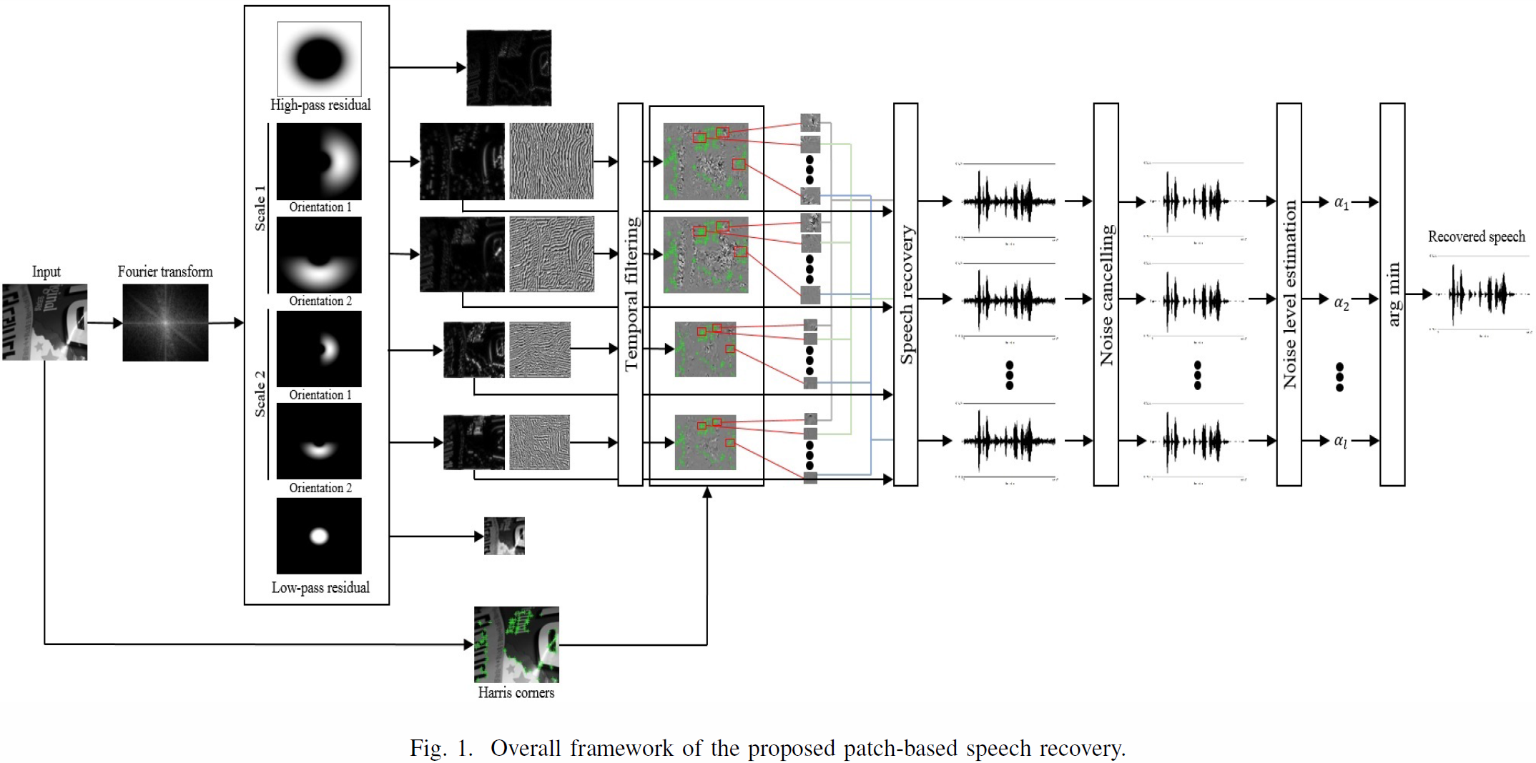
Patch-based Visual Microphone

Slide 4

Patch-based Visual Microphone
Similar to object classification?
Cat! (translation invariant)

Slide 5
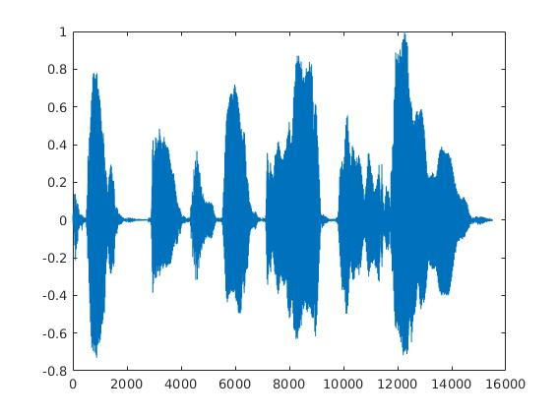
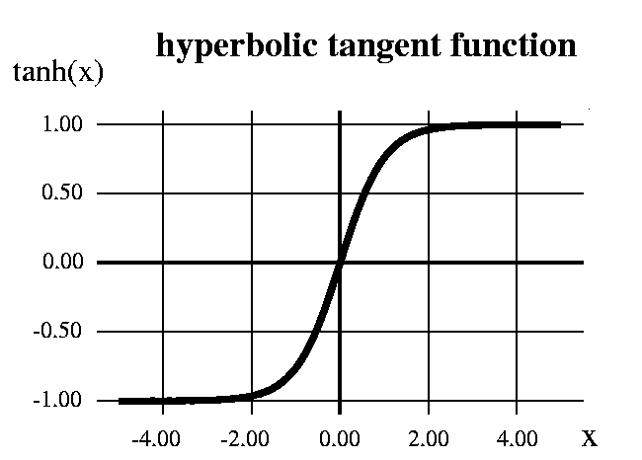
Tanh Activiation

Slide 6

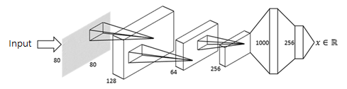
Convolutional Neural Network

Slide 7

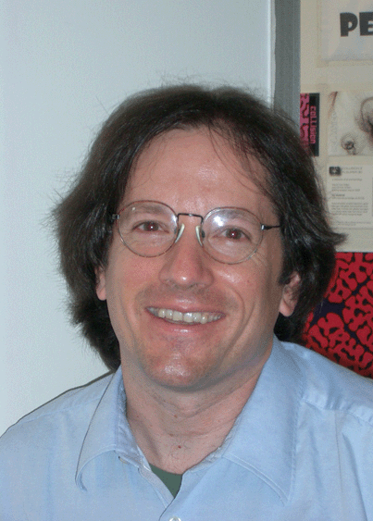
History of Motion Magnification
detecting pulse from head motions
visual microphone
material property estimation from small motions
Year 2005
Year 2012
Year 2013
Year 2014
Year 2015
Motion Magnification
(Ce Liu et al.) [1]
Eulerian method
(Hao-Yu Wu et al.) [2]
Phase-based method
(Neal Wadhwa et al.) [3]
Riesz pyramid method
(Neal Wadhwa et al.) [4]
Magnification in presence of large motions
(Elgharib et al.) [5]
personally it’s the most important algorithm
Prof. William T. Freeman @ MIT CSAIL

Slide 8
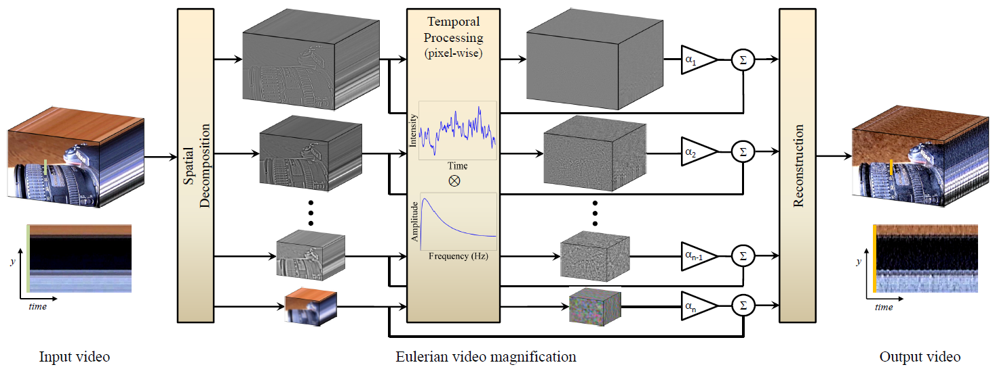
Eulerian method
Motion Magnification [1]
Eulerian method [2]
Phase-based method [3]
Riesz pyramid method [4]
Magnification in presence of large motions [5]
problem: noise is amplified together with motion

Slide 9
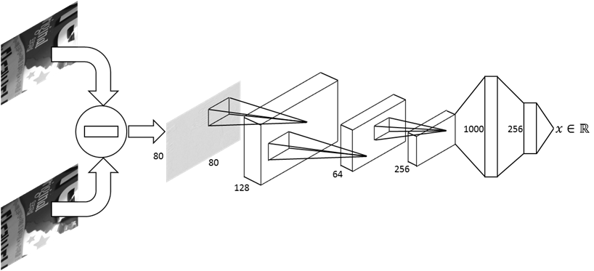
DCNN based VM
Current video frame
* Video is resized to [80, 80]
Target video frame

Slide 10
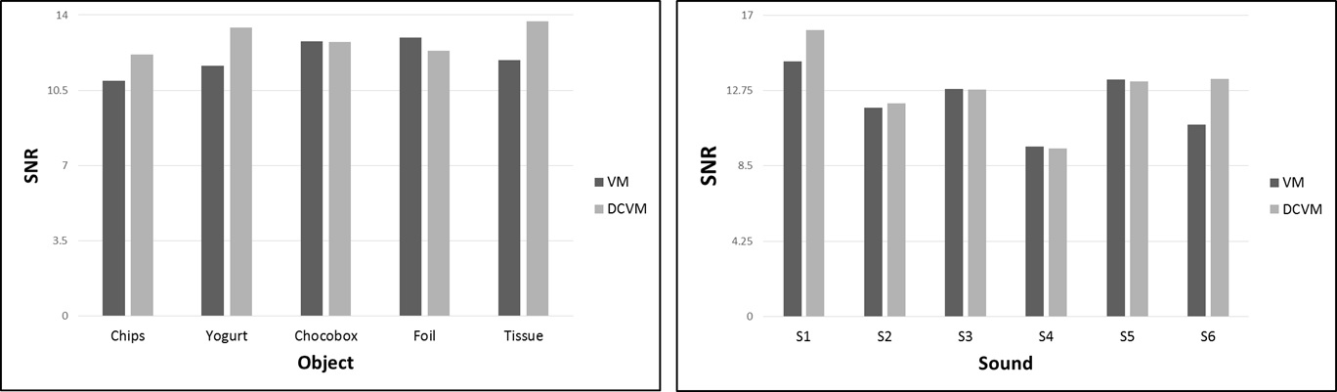
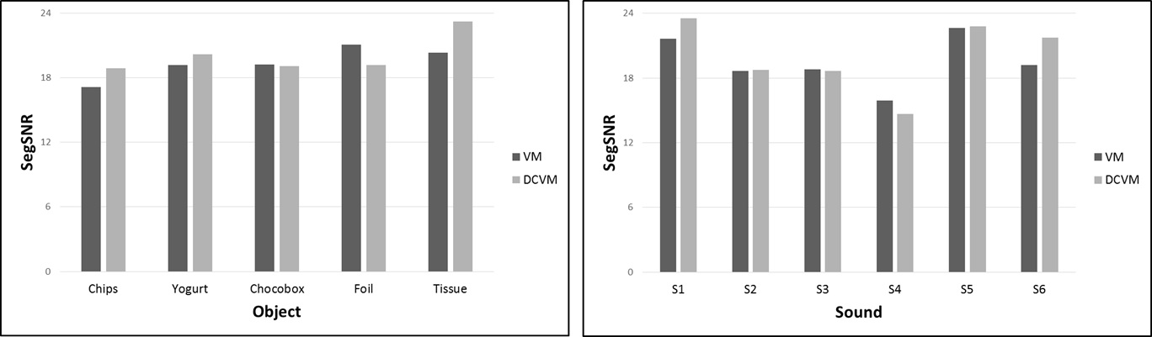
Result
To be honest, not much difference.

Slide 11

Result
 | Intensity Difference | Original Visual Microphone | DCVM
(Chocobox, S4)
(Yogurt, S6)
(Chips, S1)
Don't ask me to carry an oily rag like that.
Don't ask me to carry an oily rag like that.
Don't ask me to carry an oily rag like that.
Don't ask me to carry an oily rag like that.
Don't ask me to carry an oily rag like that.
Don't ask me to carry an oily rag like that.
She had your dark suit in greasy wash water all year.
She had your dark suit in greasy wash water all year.
She had your dark suit in greasy wash water all year.
Surprisingly, simply adding up the intensity difference recovered the speech. It shows that the intensity difference contains speech information.

Slide 12
Problem
It fails to recover the sound after around 2,000 iterations.
Why?

Slide 13
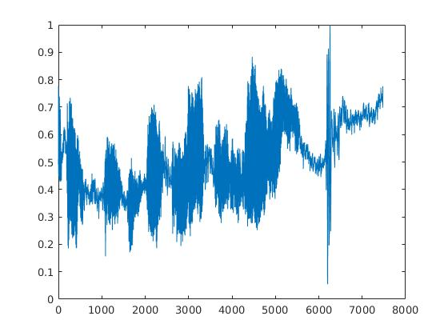
Problem
Post-processing
Actual recovered speech using the Visual Microphone
(normalized to [0,1])

Slide 14
Problem
Sequence-1
{chips, choco-box, yogurt, foil, tissue}
Sequence-2
{chips, choco-box, yogurt, foil, tissue}
Sequence-3
{chips, choco-box, yogurt, foil, tissue}
Not enough sequences
to train
deep neural network!!!
Sequence-4
{chips, choco-box, yogurt, foil, tissue}
Sequence-5
{chips, choco-box, yogurt, foil, tissue}
Sequence-6
{chips, choco-box, yogurt, foil, tissue}

Slide 15
PART TWO Improving Quality of Visual Microphone using Unsupervised Deep Bi-directional LSTM Network.

Slide 16
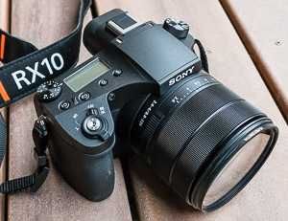
Why recovered speech doesn’t sound good?
- Sampling rate:
960
- Therefore by the Nyquist sampling theorem:
Maximum frequency in the recovered speech is 430Hz.
- 0~200Hz are band-pass filtered for speech signals.
Recovered speech contains only 200~430Hz speech signals.
Sony RX10-3:
960fps.

Slide 17
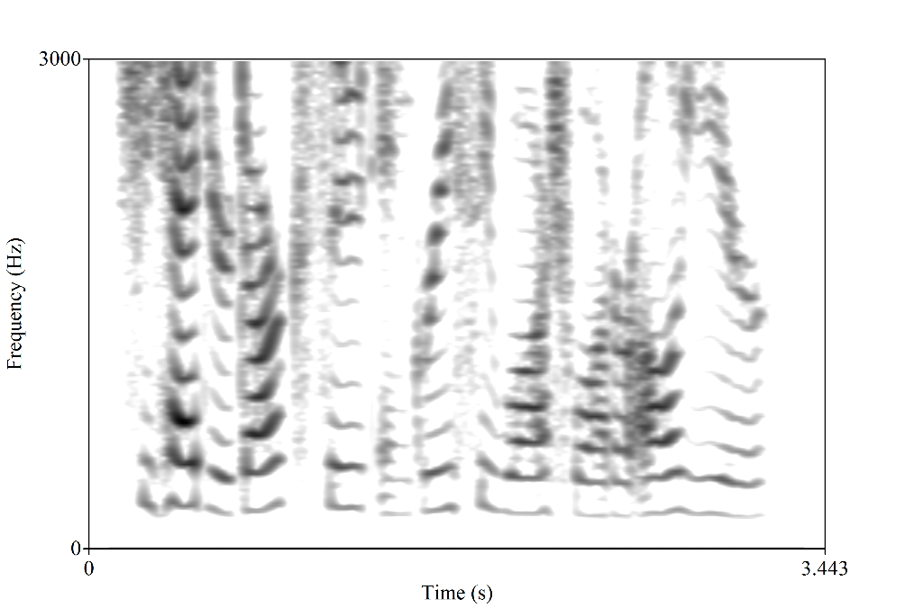
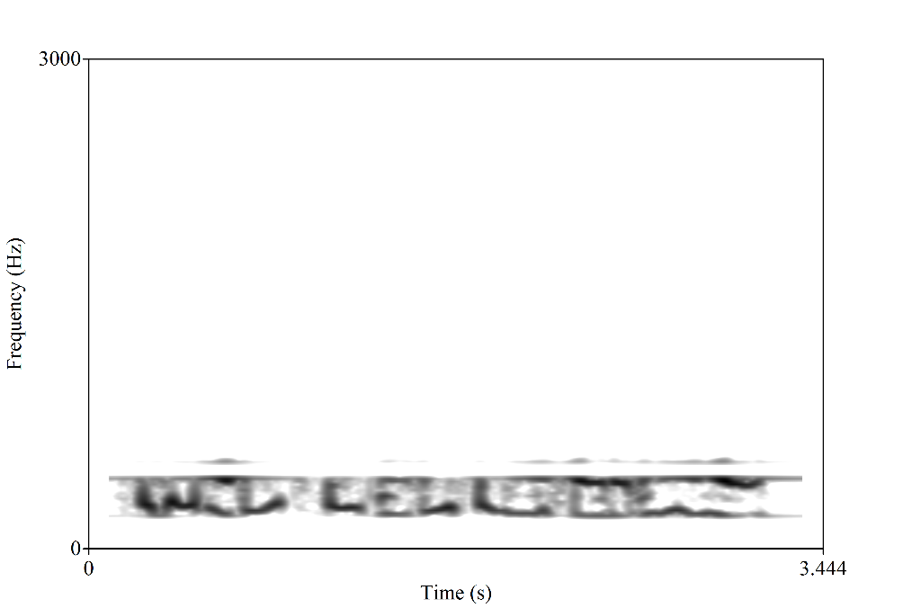
Why recovered speech doesn’t sound good?
Band-pass filtered [0Hz, 430Hz] & resampled (960fps)

Slide 18
Why recovered speech doesn’t sound good?
?
Training can be done using normal speech sequences
– i.e. unsupervised learning!!

Slide 19
Why recovered speech doesn’t sound good?
Actually, it is called audio bandwidth extension in signal processing community.
However, surprisingly no one has tried to solve this problem using Bi-directional LSTM network.

Slide 20
Deep Bi-directional LSTM network
257
Fully-connected layer
1024
512
Bi-directional LSTM layer
512
512
256
Bi-directional LSTM layer
256
1024
512
Bi-directional LSTM layer
512
257

Slide 21
TIMIT dataset
630 speakers * 10 speech files = 6,300.
Training data:
(630-3) * 10 speech files = 6,270 files.

Slide 22
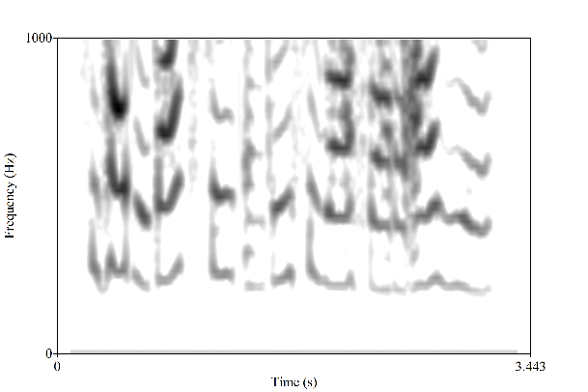
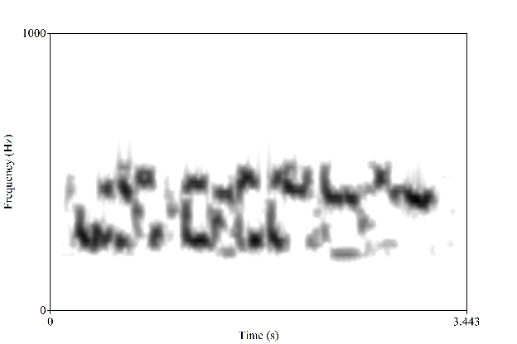
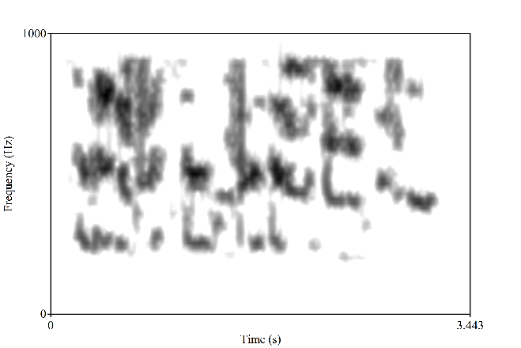
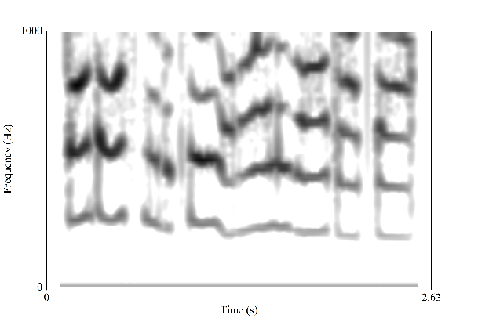
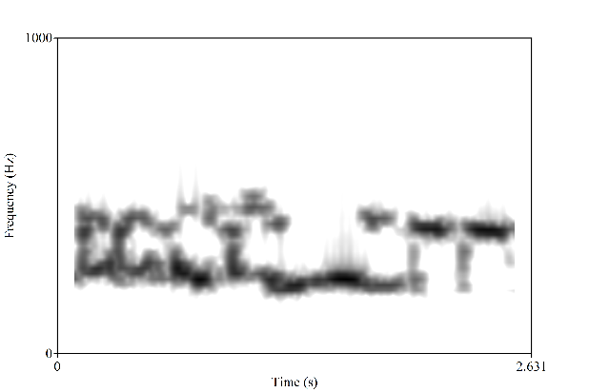
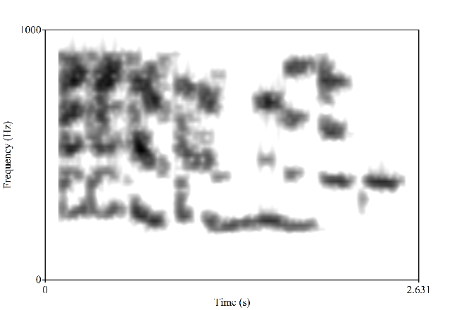
Result - English
Original Speech
Visual Microphone
Bandwidth Extended (1,000Hz)
She had your dark suit in greasy wash water all year.
She had your dark suit in greasy wash water all year.
She had your dark suit in greasy wash water all year.
Don't ask me to carry an oily rag like that.
Don't ask me to carry an oily rag like that.
Don't ask me to carry an oily rag like that.

Slide 23
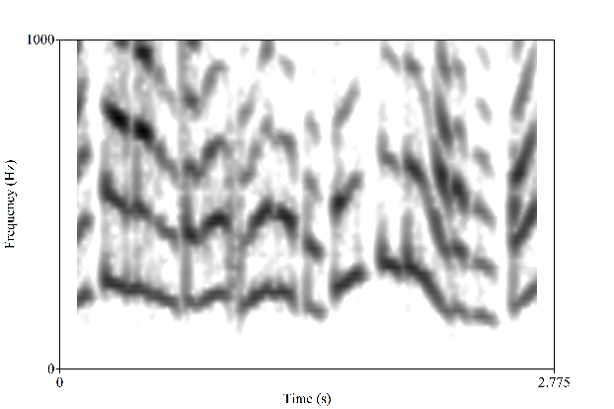
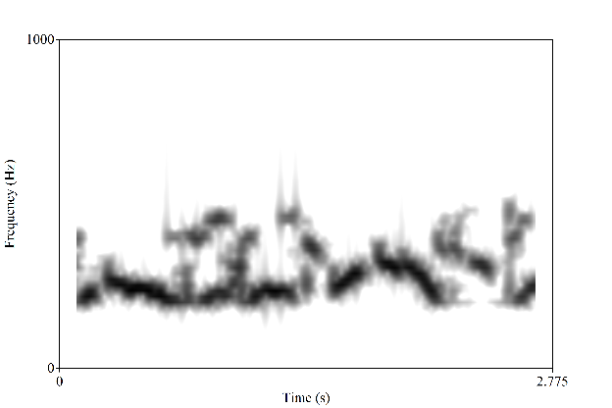
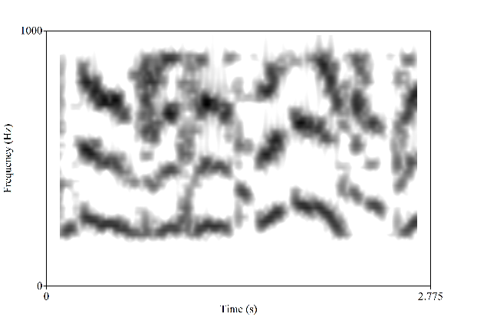
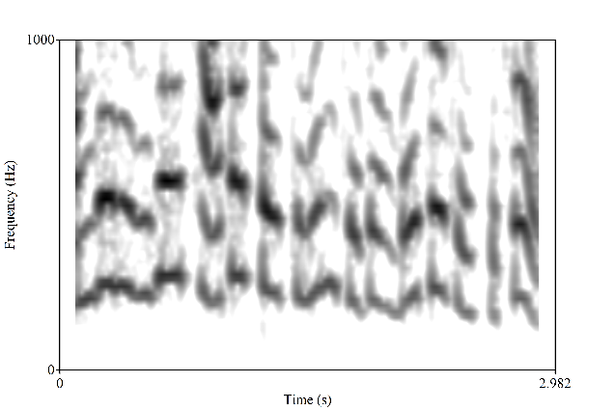
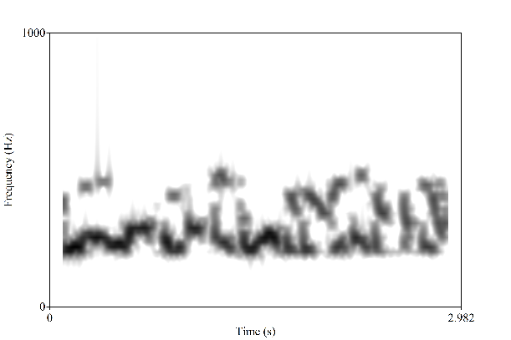
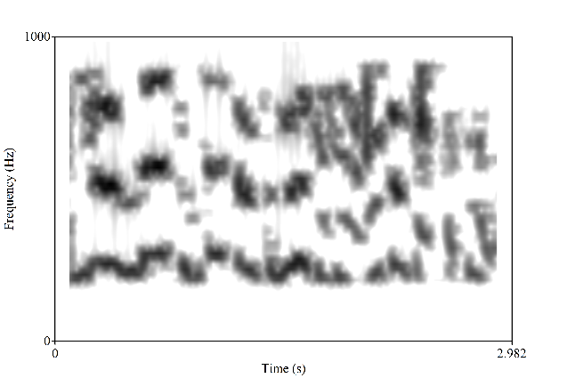
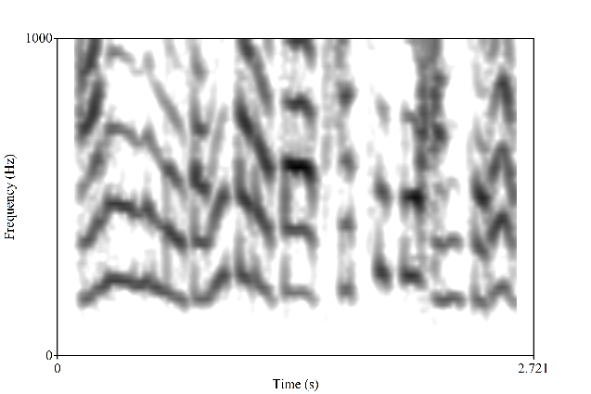
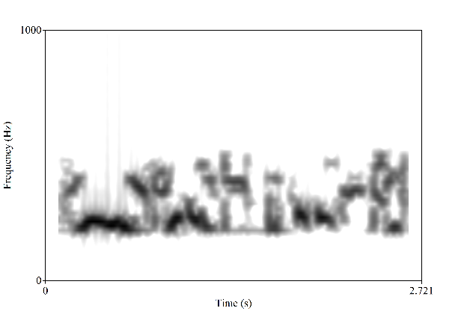
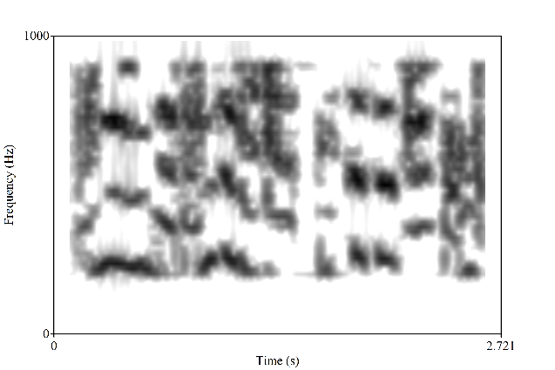
Result - Korean
Original Speech
Visual Microphone
Bandwidth Extended (1,000Hz)
아시아나 항공을 이용해주신 승객 여러분께
아시아나 항공을 이용해주신 승객 여러분께
아시아나 항공을 이용해주신 승객 여러분께
안전을 위해 좌석 벨트는 계속 매고 계시고
안전을 위해 좌석 벨트는 계속 매고 계시고
안전을 위해 좌석 벨트는 계속 매고 계시고
안에있는 물건이 떨어져 다치지 않도록
안에있는 물건이 떨어져 다치지 않도록
안에있는 물건이 떨어져 다치지 않도록

Slide 24
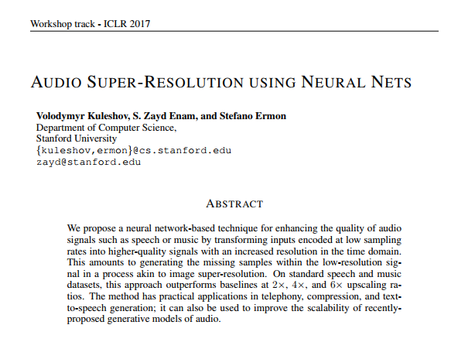
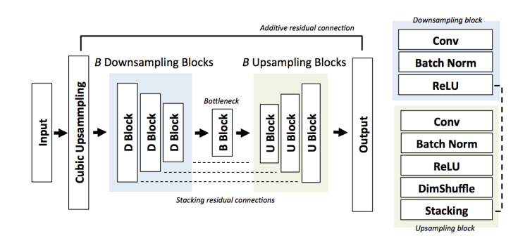
Most recent work in Audio Bandwidth Extension
https://github.com/kuleshov/audio-super-res
(*NO SOURCE CODE, only demo audio files.)

Slide 25
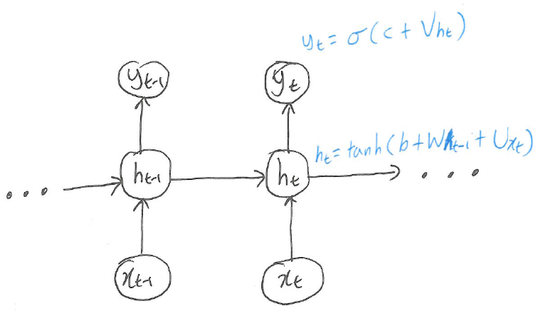
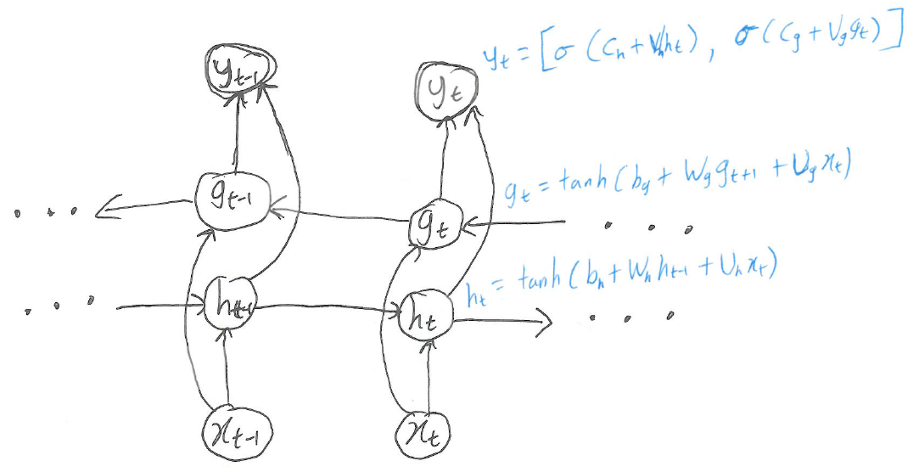
Appendix- Review on RNN

Slide 26
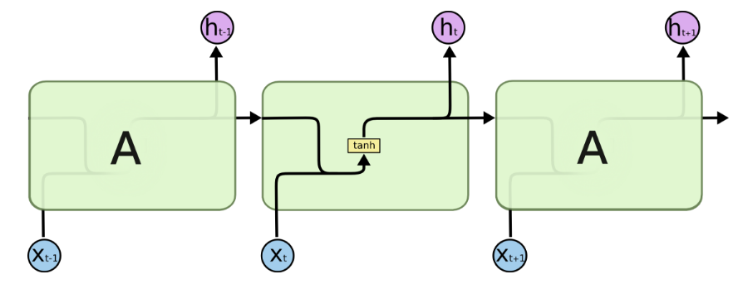
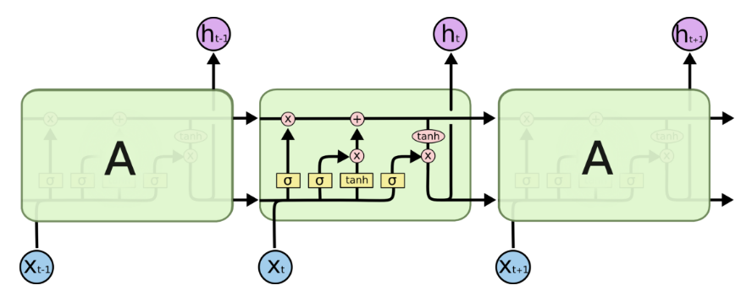
Review on RNN

Slide 27
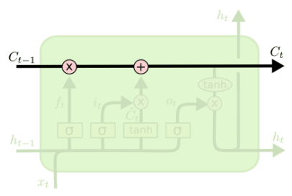
Review on RNN

Slide 28
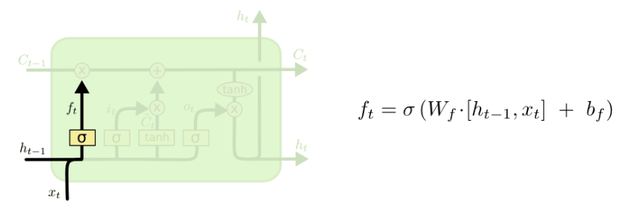
Review on RNN

Slide 29
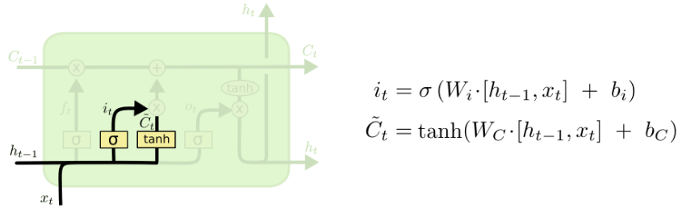
Review on RNN

Slide 30
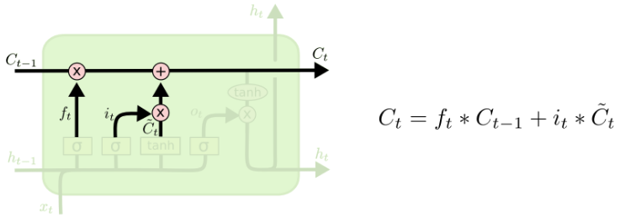
Review on RNN

Slide 31
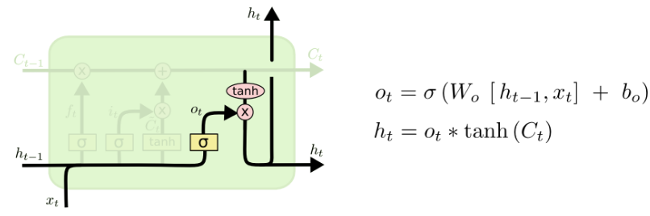
Review on RNN

